Slide 1
Advanced Frontend web Development React First Steps
Semester : | Second Sem
Module : | 2nd
Department : | BTech

Slide 2

Topics
Environment setup
Introduction to React
Components
Props (properties)
States
React App using Babel
Rendering lists of data.

Slide 3
Installation of React
Step 1: Install Node.js from browser.
Step 2: Verify Installation by command (node –v).
Step 3: Create a New React App
Create one empty folder in desktop. and open that folder in command prompt.
>> npx create-react-app project
Step 4: Navigate to Your App Directory
>> cd project
Step 5: Start the Development Server
>> npm start
Step 6: Edit Your App

Slide 4


React Extensions (vs code)
Simple React Snippets
ES7 React/Redux/GraphQL/React-Native snippets

Slide 5
Introduction to React
React is a popular JavaScript library for building user interfaces, particularly for single-page applications where a responsive and dynamic user experience is essential.
Developed and maintained by Facebook, React allows developers to create large web applications that can change data without reloading the page. It is widely used for its efficiency, flexibility, and ease of integration with other libraries and frameworks.
Advantages
Component-Based Architecture (Reuseable)
Virtual DOM for Performance
JSX Syntax
SEO Friendly with Server-Side Rendering
Rich Ecosystem of Libraries and Tools

Slide 6
Component-Based Architecture:
Encourages reusability and modularity, making it easier to manage and maintain code.
Declarative UI:
Simplifies the process of designing interactive UIs by allowing developers to describe how the UI should look based on the current state.
Virtual DOM:
Enhances performance by minimizing direct manipulation of the real DOM, leading to faster updates and rendering
JSX Syntax:
Combines HTML-like syntax with JavaScript, making it easier to visualize the UI structure and write components.
Performance Optimization:
Features like code splitting and lazy loading help improve application performance by loading only the necessary components.

Slide 7
Rich Ecosystem:
Offers a wide range of libraries and tools (e.g., React Router, Redux) that enhance functionality and streamline development.
Strong Community Support:
A large community of developers provides extensive resources, tutorials, and third-party libraries, facilitating learning and problem-solving.
Easy Integration:
Can be easily integrated with other libraries or existing projects, making it flexible for various development needs.
Cross-Platform Development:
React Native allows developers to build mobile applications using the same React principles, enabling code reuse across web and mobile platforms.

Slide 8
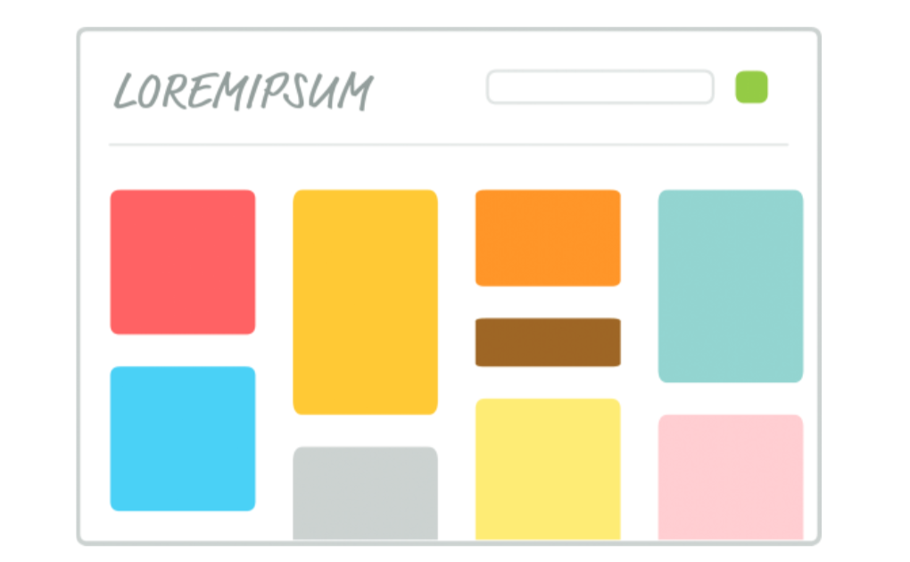
Components

Slide 9
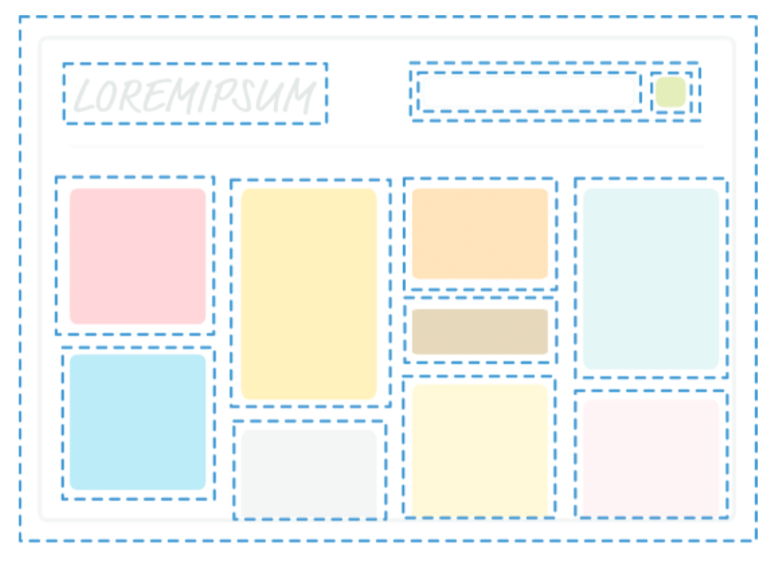
Components

Slide 10
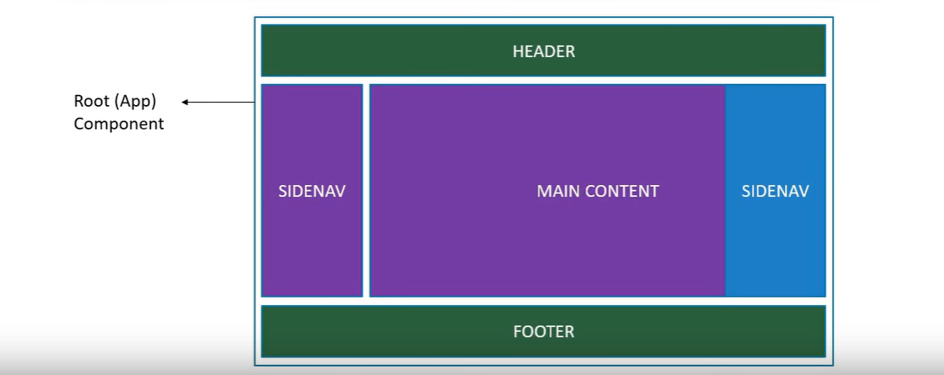
Components

Slide 11
Components
In React, components are the building blocks of the user interface. They allow you to break down the UI into reusable, self-contained pieces, making it easier to manage and maintain your application. Here’s a detailed overview of components in React:
Functional Components:
These are JavaScript functions that return JSX (JavaScript XML). They are simpler and easier to read and test. With the introduction of Hooks in React 16.8, functional components can also manage state and side effects.
Class Components:
These are ES6 classes that extend from React. Component. Class components can hold and manage their own state and lifecycle methods. But Functional components are now preferred for most use cases.

Slide 12
Simple Functional Component
import React from 'react’;
function Profile() {
return (
<div>
<h2> Profile</h2>
<p> vivek </p>
<p>svyasa@yahoo </p>
</div>
);
}
export default Profile;
In React, when creating functional components, you may often need to wrap multiple elements in a single parent tag. This is necessary because a component must return a single React element. If you want to return multiple elements, you can use a parent tag (like a <div>, <section>, etc.) or a special feature called React Fragments.

Slide 13
Class Component
A class component must include the extends React.Component statement. This statement creates an inheritance to React.Component, and gives your component access to React.Component's functions.
The component also requires a render() method, this method returns HTML.

Slide 14
Class Component
import React, { Component } from 'react';
class Vivek extends React.Component {
render() {
return <h2>Hi, I am vivek!</h2>;
}
}
Export default Vivek;

Slide 15
Props (Properties)
Props (short for "properties") are a mechanism for passing data and event handlers from one component to another, typically from a parent component to a child component. Props are a fundamental concept in React, enabling components to be dynamic and reusable.
Props are immutable, meaning that a child component cannot modify the props it receives. This ensures a unidirectional data flow, which makes the application easier to understand and debug.
Props allow you to pass dynamic data to components, enabling them to render different content based on the data they receive.
In functional components, props are received as function arguments.
In Class Components, props are accessed using this.props.

Slide 16
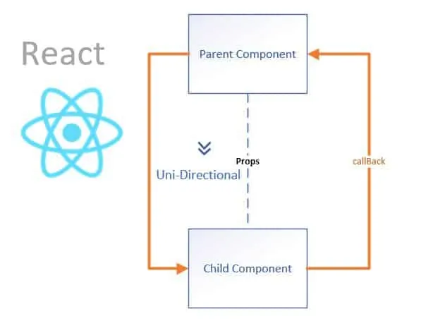
Props (Properties) – Functional Component
import React from 'react';
function Greeting({ name }) {
return (<div> <h1>Hello, {name}!</h1> <div>);
}
function App() {
return (
<div>
<Greeting name="Alice" />
<Greeting name="Bob" />
</div>
);}
export default App;

Slide 17
Using Props in a Class Component
import React, { Component } from 'react';
class Greeting extends Component {
render() { return <h1>Hello, {this.props.name}!</h1>; }
}
class App extends Component {
render() { return <Greeting name="Alice" />; }
}
export default App;

Slide 18
Default Props:
import React from 'react';
function Greeting(props) {
return <h1>Hello, {props.name}!</h1>;
}
Greeting.defaultProps = { name: "Guest",};
function App() {
return <Greeting />;
}
export default App;

Slide 19
Exercise
Create a functional component named Welcome.
The component should accept a name as a prop.
Display a message like: "Hello, [name]! Welcome to React.“
Use the Welcome component inside the App component.
Pass different names as props to test reusability.
Create Multiple Functional Components and use in Main Component.

Slide 20
Solution -1
import React from "react";
function Welcome(props) {
return <h2>Hello, {props.name}! Welcome to React.</h2>; }
function App() {
return (
<div> <h1>React Beginner Exercise</h1>
<Welcome name="Alice" />
<Welcome name="Bob" />
<Welcome name="Charlie" />
</div>
);
}
export default App;

Slide 21
Solution - 2
// Main Component that uses both components
function App() {
return (
<div>
<h1>Welcome to My React App</h1>
{/* Using Greeting Component */}
<Greeting name="Alice" />
<Greeting name="Bob" />
{/* Using Message Component */}
<Message text="React is awesome!" />
<Message text=“You are awesome!" />
</div>
);
}
export default App;
import React from "react";
// First Functional Component
function Greeting({ name }) {
return <h2>Hello, {name}!</h2>;
}
// Second Functional Component
function Message({ text }) {
return <p>Message: {text}</p>;
}

Slide 22
State
state is an object that holds data that can change over time and determines the behavior of a component.
When the state of a component changes, React automatically re-renders the component to reflect the updated data.
State is Local – It belongs to a specific component and is not accessible by other components unless explicitly passed as props.
State is Mutable – It can be updated using useState (for functional components) or this.setState (for class components).
Triggers Re-Rendering – Any state change causes the component to re-render and update the UI.

Slide 23
State
State is a built-in feature in React that lets components hold and manage data that can change over time. When state changes, React automatically re-renders the component to update the UI.
Think of state as a memory for your component.
For example:
A counter that increases when a button is clicked.
A form where users enter data.
A toggle switch that changes between ON and OFF.

Slide 24
When to Use State?
When data changes dynamically within a component (e.g., user input, API response, toggling UI elements).
Avoid using state for static data or computed values (use props or derived state instead).
Always use useState (for functional components) or this.setState (for class components) to update state.
Keep state as minimal as possible (store only what is necessary).
Don’t modify state directly.
count = count + 1; (This won’t trigger a re-render)
Use setCount(count + 1);

Slide 25
State
import { useState } from "react";
function Counter() {
const [count, setCount] = useState(0); // Declare state
return (
<div>
<p>Count: {count}</p>
<button onClick={() => setCount(count + 1)}>Increment</button>
</div>
);
}
export default Counter;

Slide 26
Counter Using State
import { useState } from "react";
function Counter() {
const [count, setCount] = useState(0); // Initial state is 0
return (
<div>
<h2>Counter: {count}</h2>
<button onClick={() => setCount(count + 1)}>Increase</button>
<button onClick={() => setCount(count - 1)}>Decrease</button>
<button onClick={() => setCount(0)}>Reset</button>
</div>
);
}
export default Counter;

Slide 27
Toggle Button (Show/Hide Text)
import { useState } from "react";
function ToggleText() {
const [isVisible, setIsVisible] = useState(true);
return (
<div>
{isVisible && <h3>Hello, React!</h3>}
<button onClick={() => setIsVisible(!isVisible)}>
{isVisible ? "Hide" : "Show"}
</button>
</div>
);
}
export default ToggleText;

Slide 28
Babel
Babel is an open-source JavaScript compiler and transpiler that allows using the latest JavaScript(ES6+) features, ensuring compatibility across older and newer browsers. Babel enables React developers to write clean, modern syntax without worrying about browser limitations.
React applications often use JSX syntax to define components. Since browsers don’t natively understand JSX, Babel converts it into standard JavaScript functions using the @babel/preset-react plugin.

Slide 29
Babel
Parsing: Babel reads the source code and converts it into an Abstract Syntax Tree (AST).
Transformation: Applies transformations to the AST using presets and plugins to handle JSX and ES6+ features.
Code Generation: Converts the transformed AST back into JavaScript code.

Slide 30
List
React Lists are used to display a collection of similar data items like an array of objects and menu items. It allows us to dynamically render the array elements and display repetitive data.
To render a list in React, we will use the JavaScript array map function.
We will iterate the array using map() and return the required element in the form of JSX to render the repetitive elements.

Slide 31
List
function App() {
const items = ['Apple', 'Banana', 'Cherry'];
return (
<div>
<h1>My Fruit List</h1>
<ul>
{items.map((item, index) => (
<li key={index}>{item}</li>
))} </ul> </div> );
}
export default App;

